Slide 1

DungeonFest
A text-based dungeon crawler!
Created by: Jackson Campbell

Slide 2
Table of contents
How To Play
The Player
Enemies
Zombie
Skeleton
Rooms
Basic Room
Treasure Room
Battle Room
Exit Room
Ending

Slide 3
How to play
Once the game loads, you can choose to start the game or exit right away.
If you choose to start the game, the first floor will initiate, and you can move!
One of four rooms will be your starter: Basic Room, Treasure Room, Battle Room, Exit Room
You can move forward or behind each room, and the rooms in said positions will be revealed before entering them.
Make your way through each floor, finding the exit before moving onto the next.
Once you die, the game is over, and the program ends.
Back to contents

Slide 4

The player
You play the game!
Jump through floors as you make your way deeper into the dungeon, with no end in sight.
Fight monsters and gain treasure!
Once you die, it’s game over and the game ends!
Back to contents

Slide 5
Enemies
Back to contents

Slide 6

Enemies
Zombies
Zombies have lower health, yet higher attack and defense as they have muscles to control what they do and defend themselves a bit easier.
Main Attack: Club
Stats:
Health: 20
Attack: 10
Defense: 6
Back to contents

Slide 7
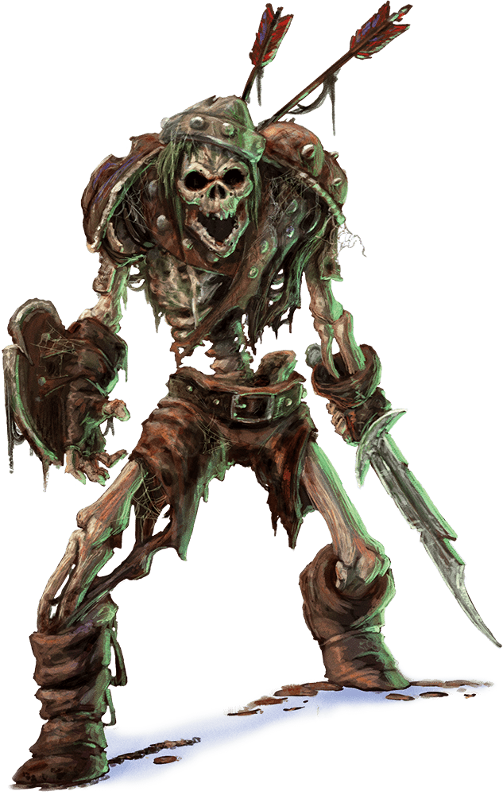
Enemies
Skeletons
Skeletons have high health, as they’ve strengthened their bones over time. However, they have low attack and defense stats to compromise.
Main Attack: Head Hitter
Stats:
Health: 10
Attack: 6
Defense: 4
Back to contents

Slide 8
Rooms
Back to contents

Slide 9
Basic Room
Just a basic room, doesn’t contain anything for the player to do.
Can move forward or behind from here
Back to contents

Slide 10
Treasure Room
Treasure Room! Allows the player to have their stats boosted once entering.
Has a 1/20 chance to become a mimic room, damaging and weakening the player instead.
Player can move forwards or behind from here.
Back to contents

Slide 11
Battle room
A battle room! Will contain either monster in the game, and the player will have to fight!
You can run from this battle, but you’ll be attacked and lose health if you do!
You can move forwards or behind a room once the battle is over.
If you lose the battle, it’s game over!
Back to contents

Slide 12

Exit Room
You found the exit! You can now choose to move to the next floor or stay on the current floor for a bit longer.
Back to contents

Slide 13
Good luck!
If you can survive…
Back to contents

